Slide 1
Epidemiologic Study of the Manhattan COVID-19 Data During the Period March 7, 2020 to June 4, 2020
Authors: James Boggs, Camilo Ramirez
Date: March 16, 2023
Venue: MATH 420 Mid-Semester Project Presentation

Slide 2
Problem Description
Datasets:
Manhattan Covid Data
District of Columbia Covid Data
Goals:
By fitting the model to the data, we achieve estimate for the parameters of the model which can be interpreted to real life characteristics of the virus
By fitting the model to only the beginning of the data we see if the model is capable of making predictions about things such as the maximum number of concurrent cases and the total number of deaths

Slide 3
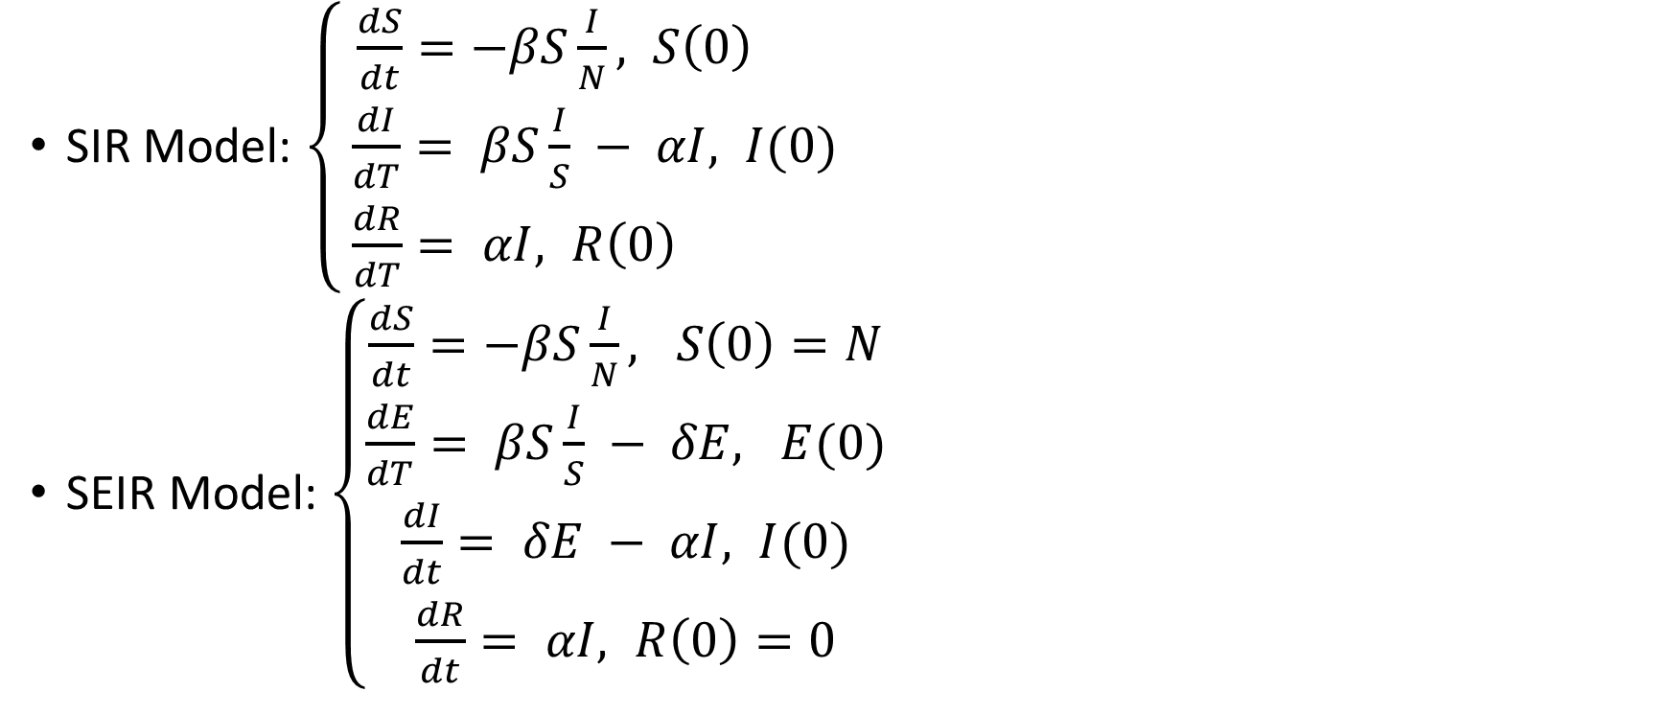
Models Used
SIR Model: $\left\{\begin{aligned}\frac{dS}{dt}=−βS\frac{I}{N}, S\left(0\right) \\ \frac{dI}{dT}= βS\frac{I}{S} − αI, I(0) \\ \frac{dR}{dT}= αI, R\left(0\right) \end{aligned}\right.$
SEIR Model: $\left\{\begin{aligned}\frac{dS}{dt}=−βS\frac{I}{N}, S\left(0\right)=N \\ \frac{dE}{dT}= βS\frac{I}{S} − δE, E(0) \\ \frac{dI}{dt}= δE − αI, I(0) \\ \frac{dR}{dt}= αI, R\left(0\right)=0\end{aligned}\right.$

Slide 4
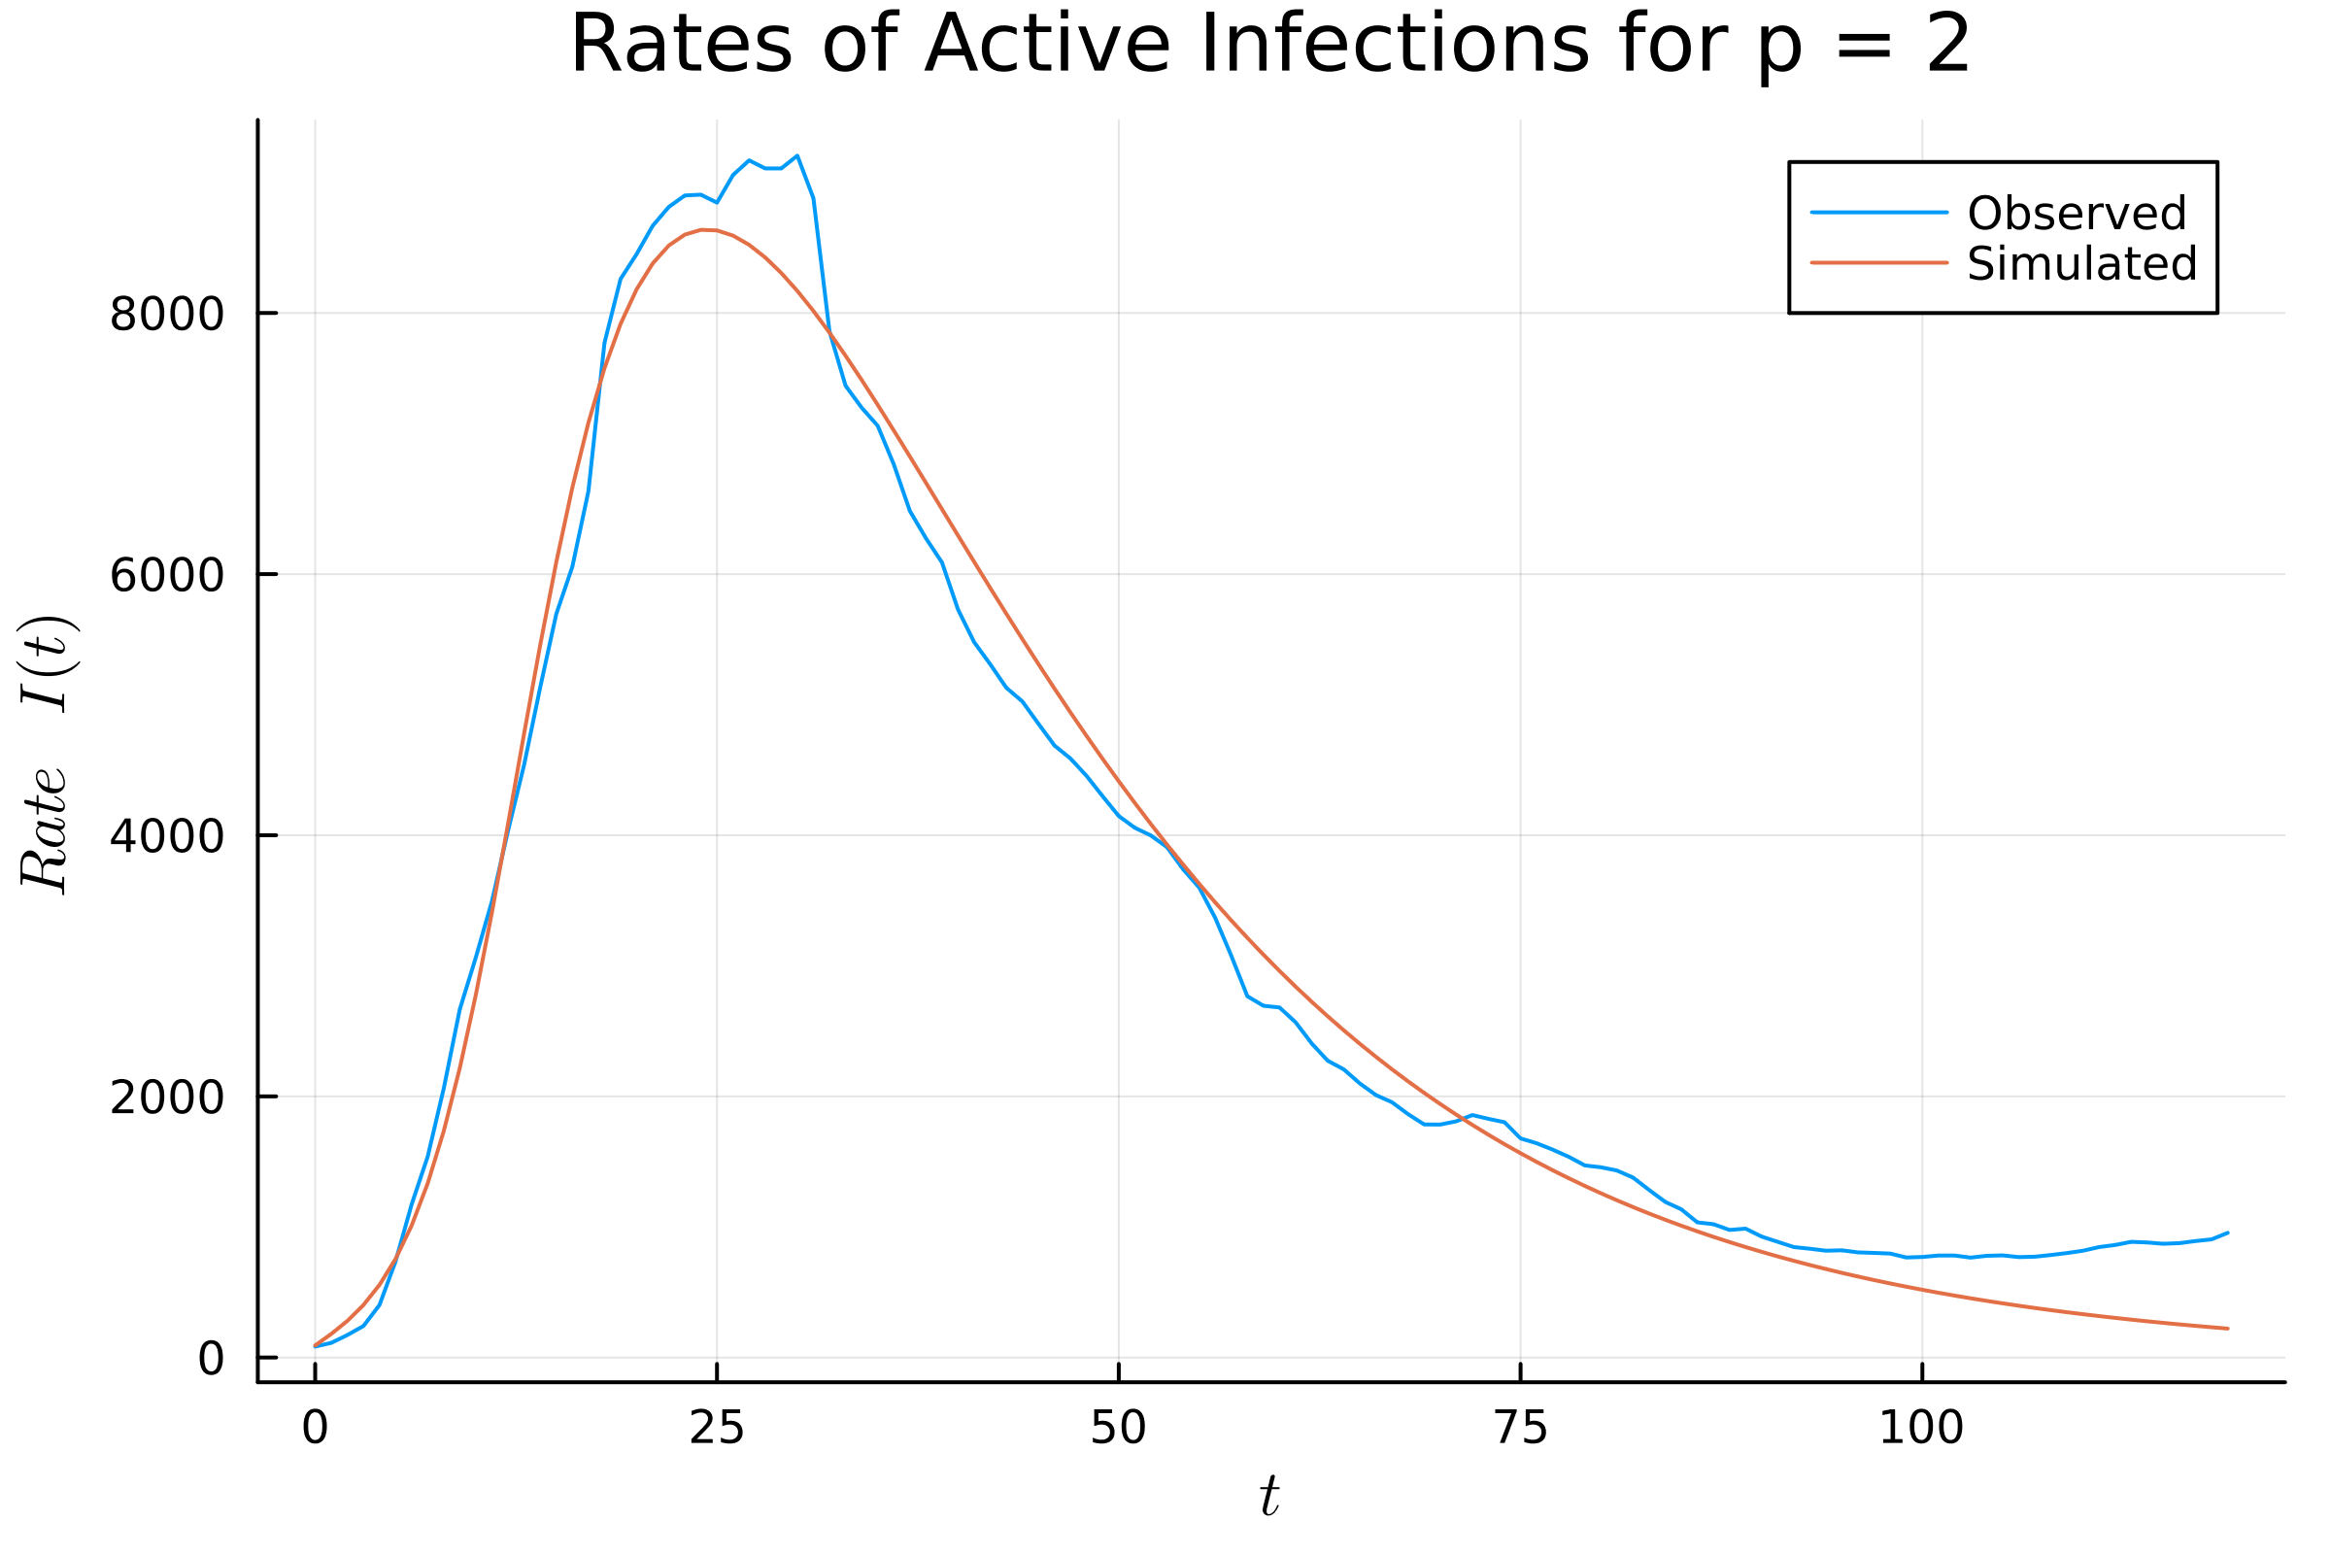
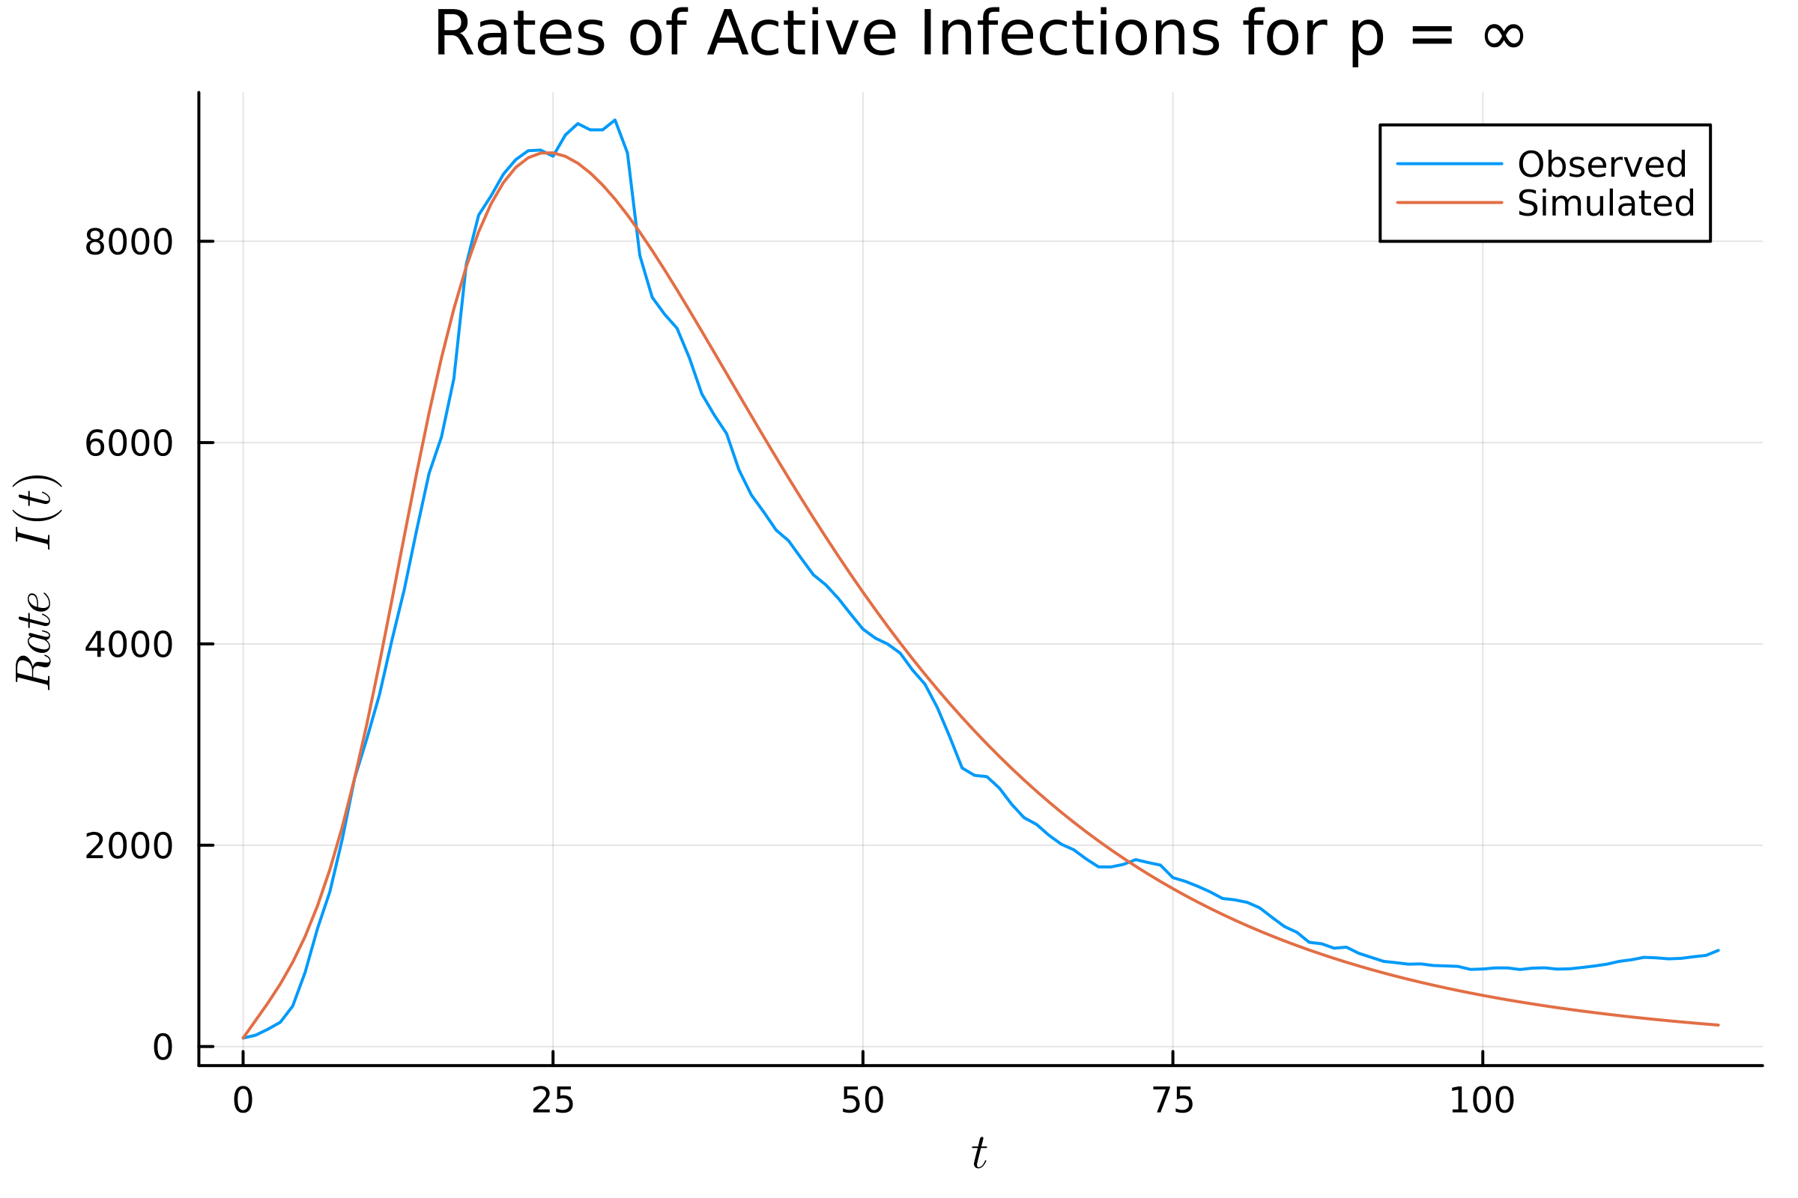
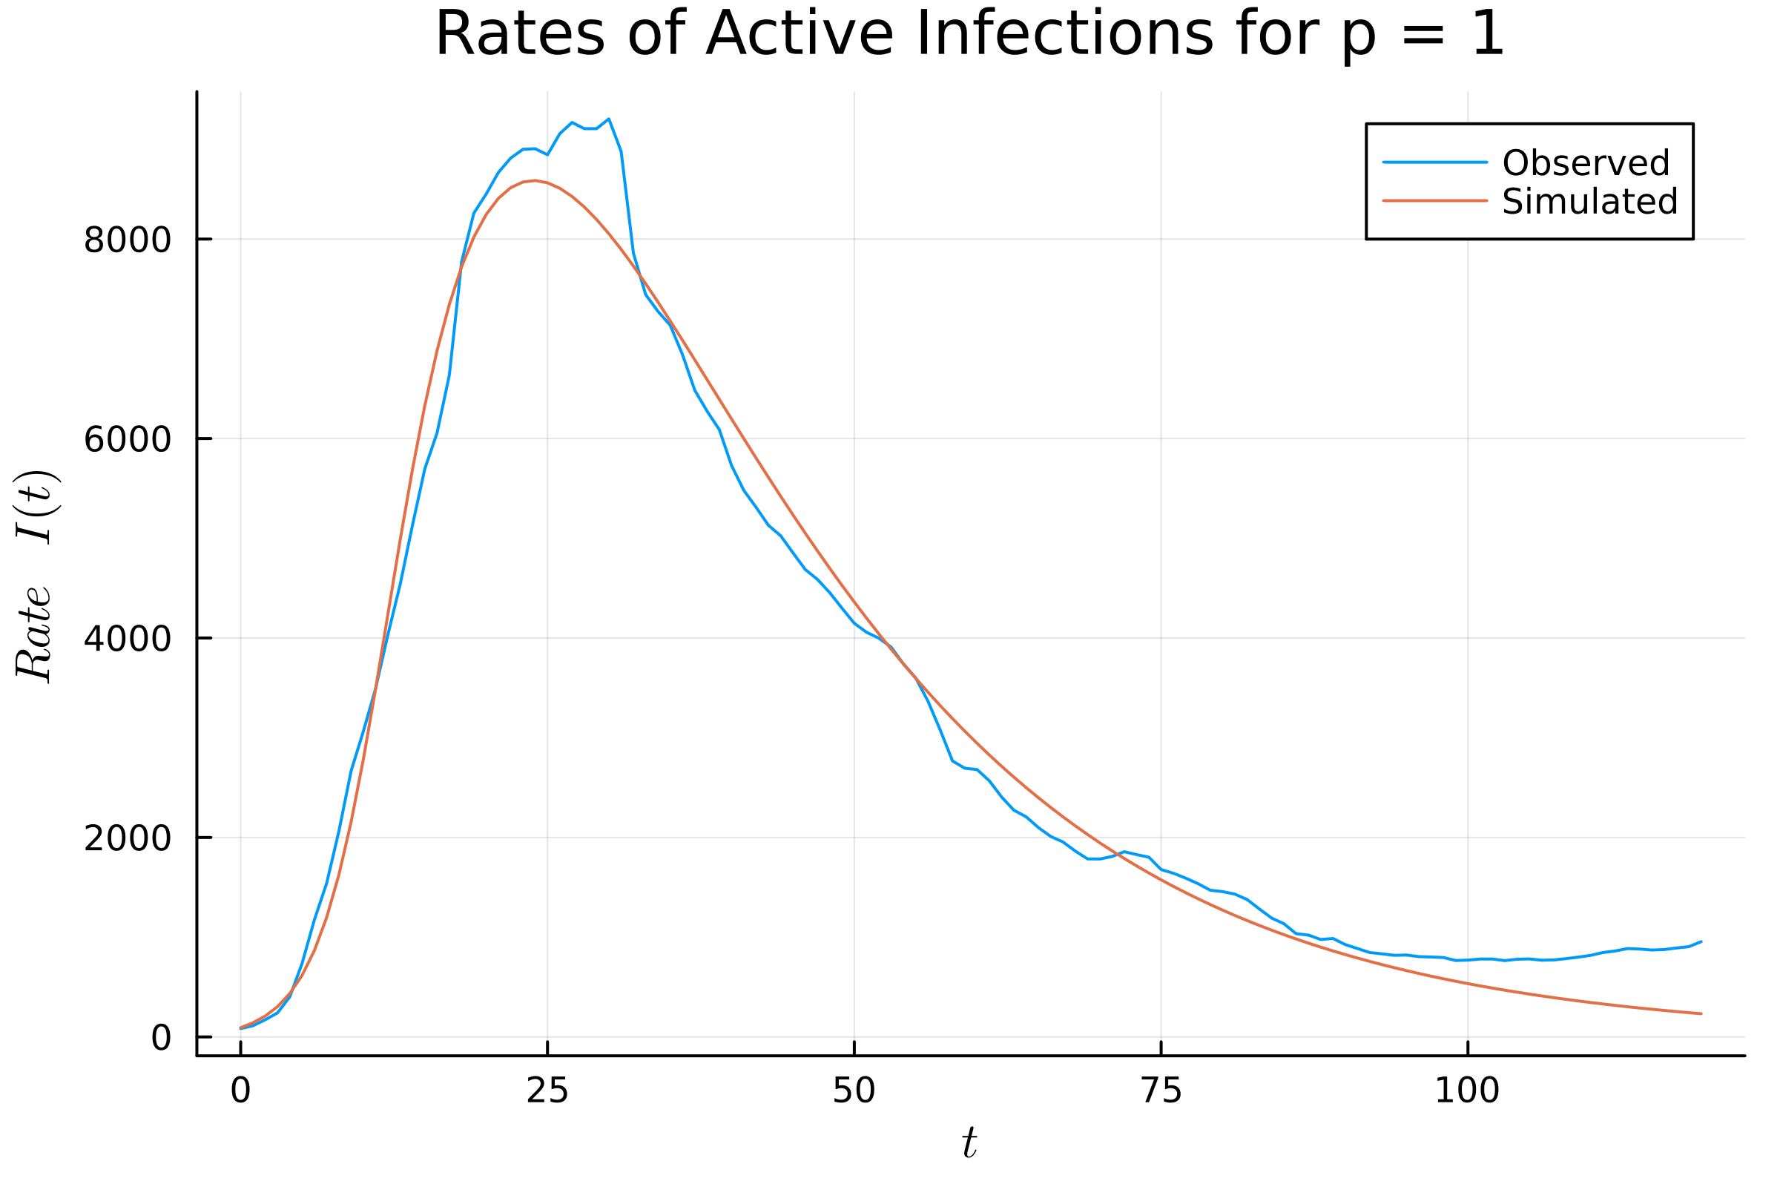
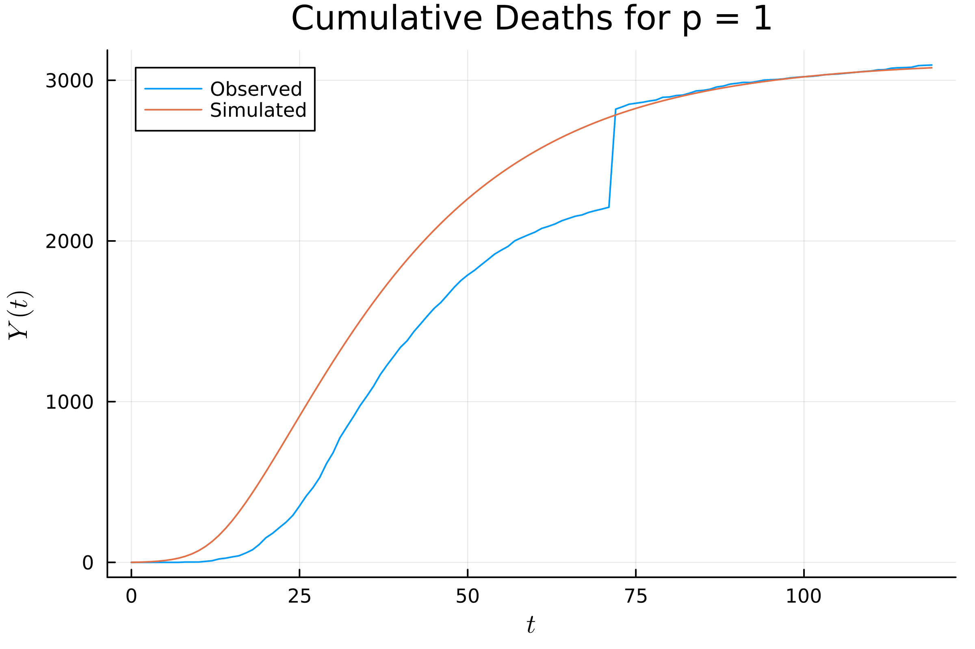
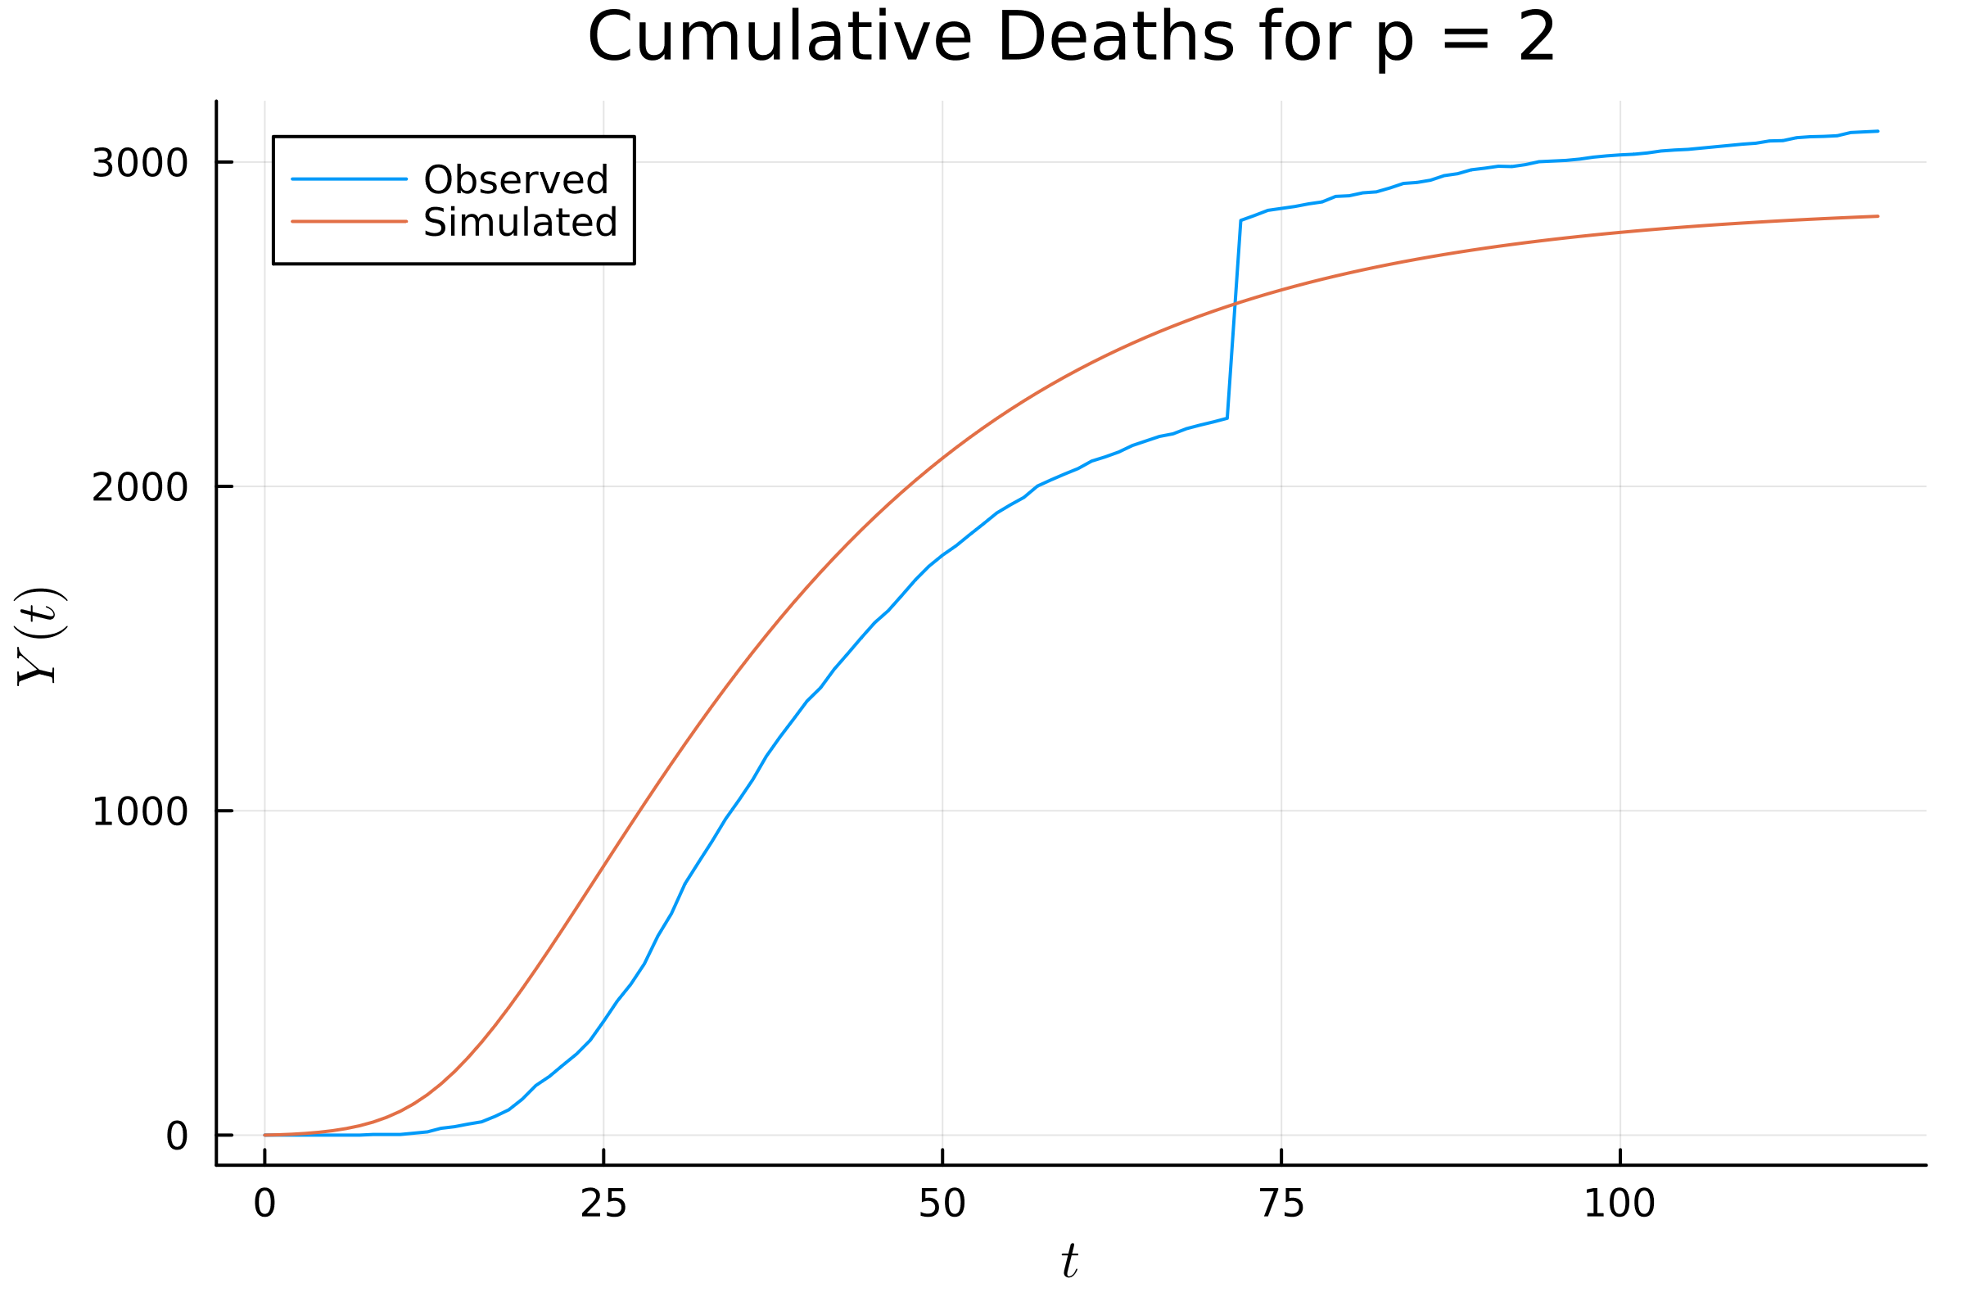
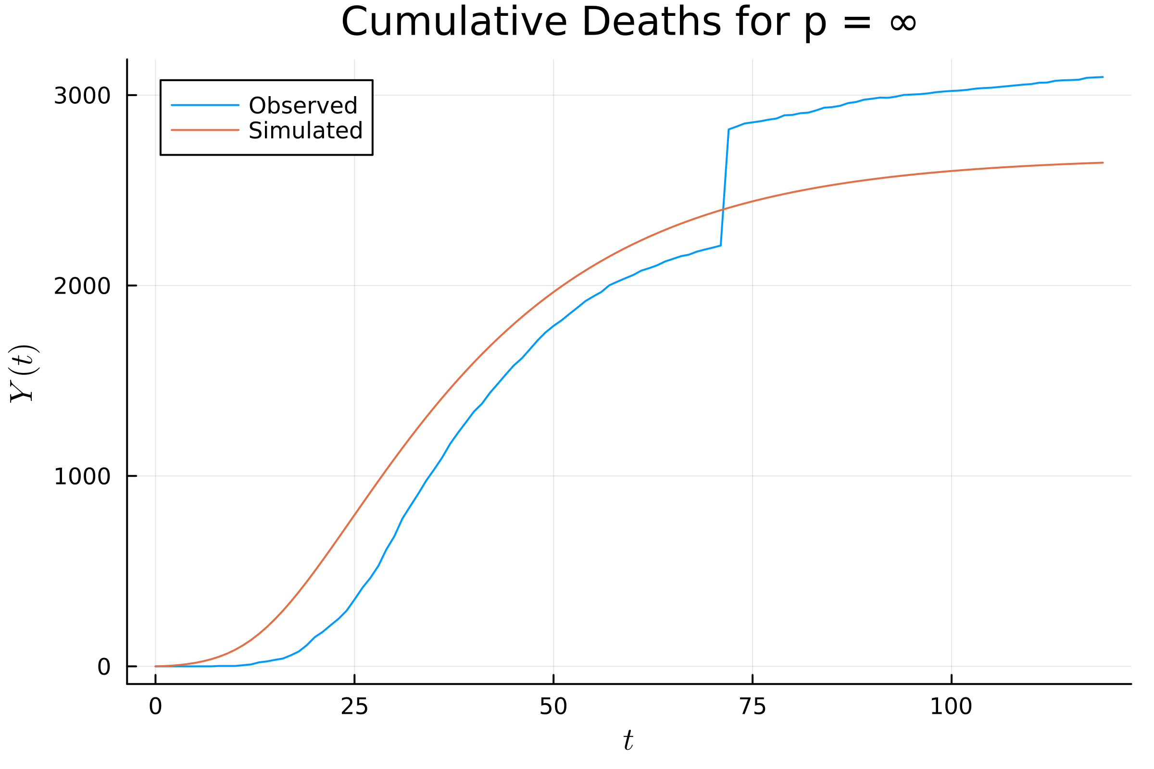
SEIR Model

Slide 5

Range of parameters tested SEIR
α: [0.03, 0.4]
$R_{0}$: [1.5, 50]
δ = 0.1
N / $N_{max}=\left[0.005, 0.1\right]$
E(0) / I($t_{0}$) = [1, 30]
I(0) / I($t_{0}$) = [1, 30]

Slide 6
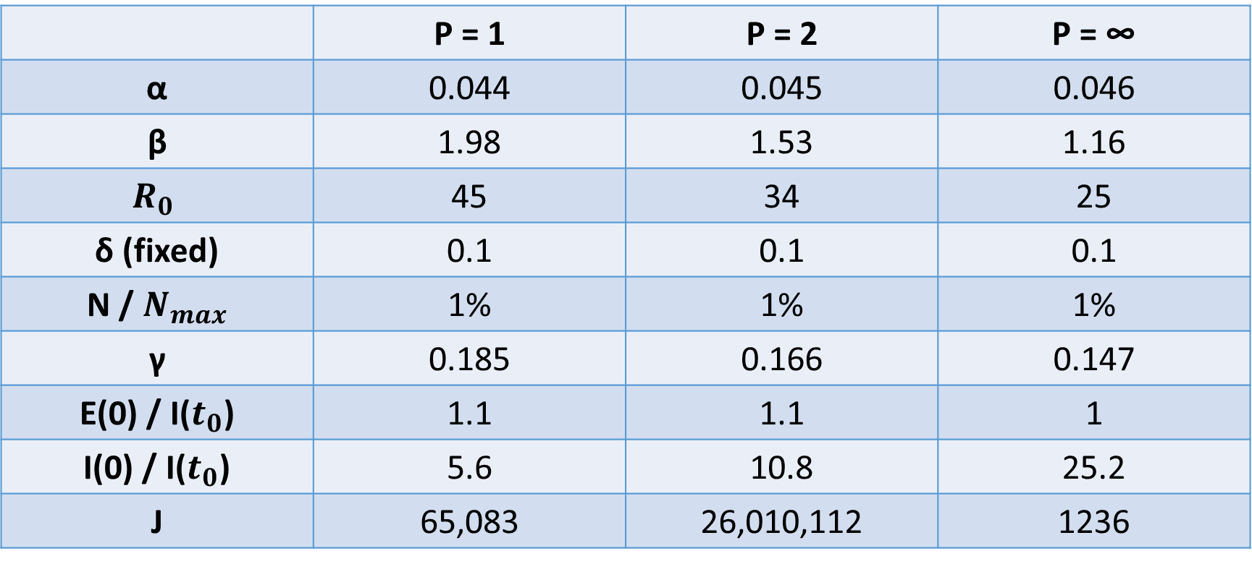
SEIR Model Parameters
 | P = 1 | P = 2 | P = ∞
α | 0.044 | 0.045 | 0.046
β | 1.98 | 1.53 | 1.16
$$R_{0}$$ | 45 | 34 | 25
δ (fixed) | 0.1 | 0.1 | 0.1
N / $N_{max}$ | 1% | 1% | 1%
γ | 0.185 | 0.166 | 0.147
E(0) / I($t_{0}$) | 1.1 | 1.1 | 1
I(0) / I($t_{0}$) | 5.6 | 10.8 | 25.2
J | 65,083 | 26,010,112 | 1236

Slide 7
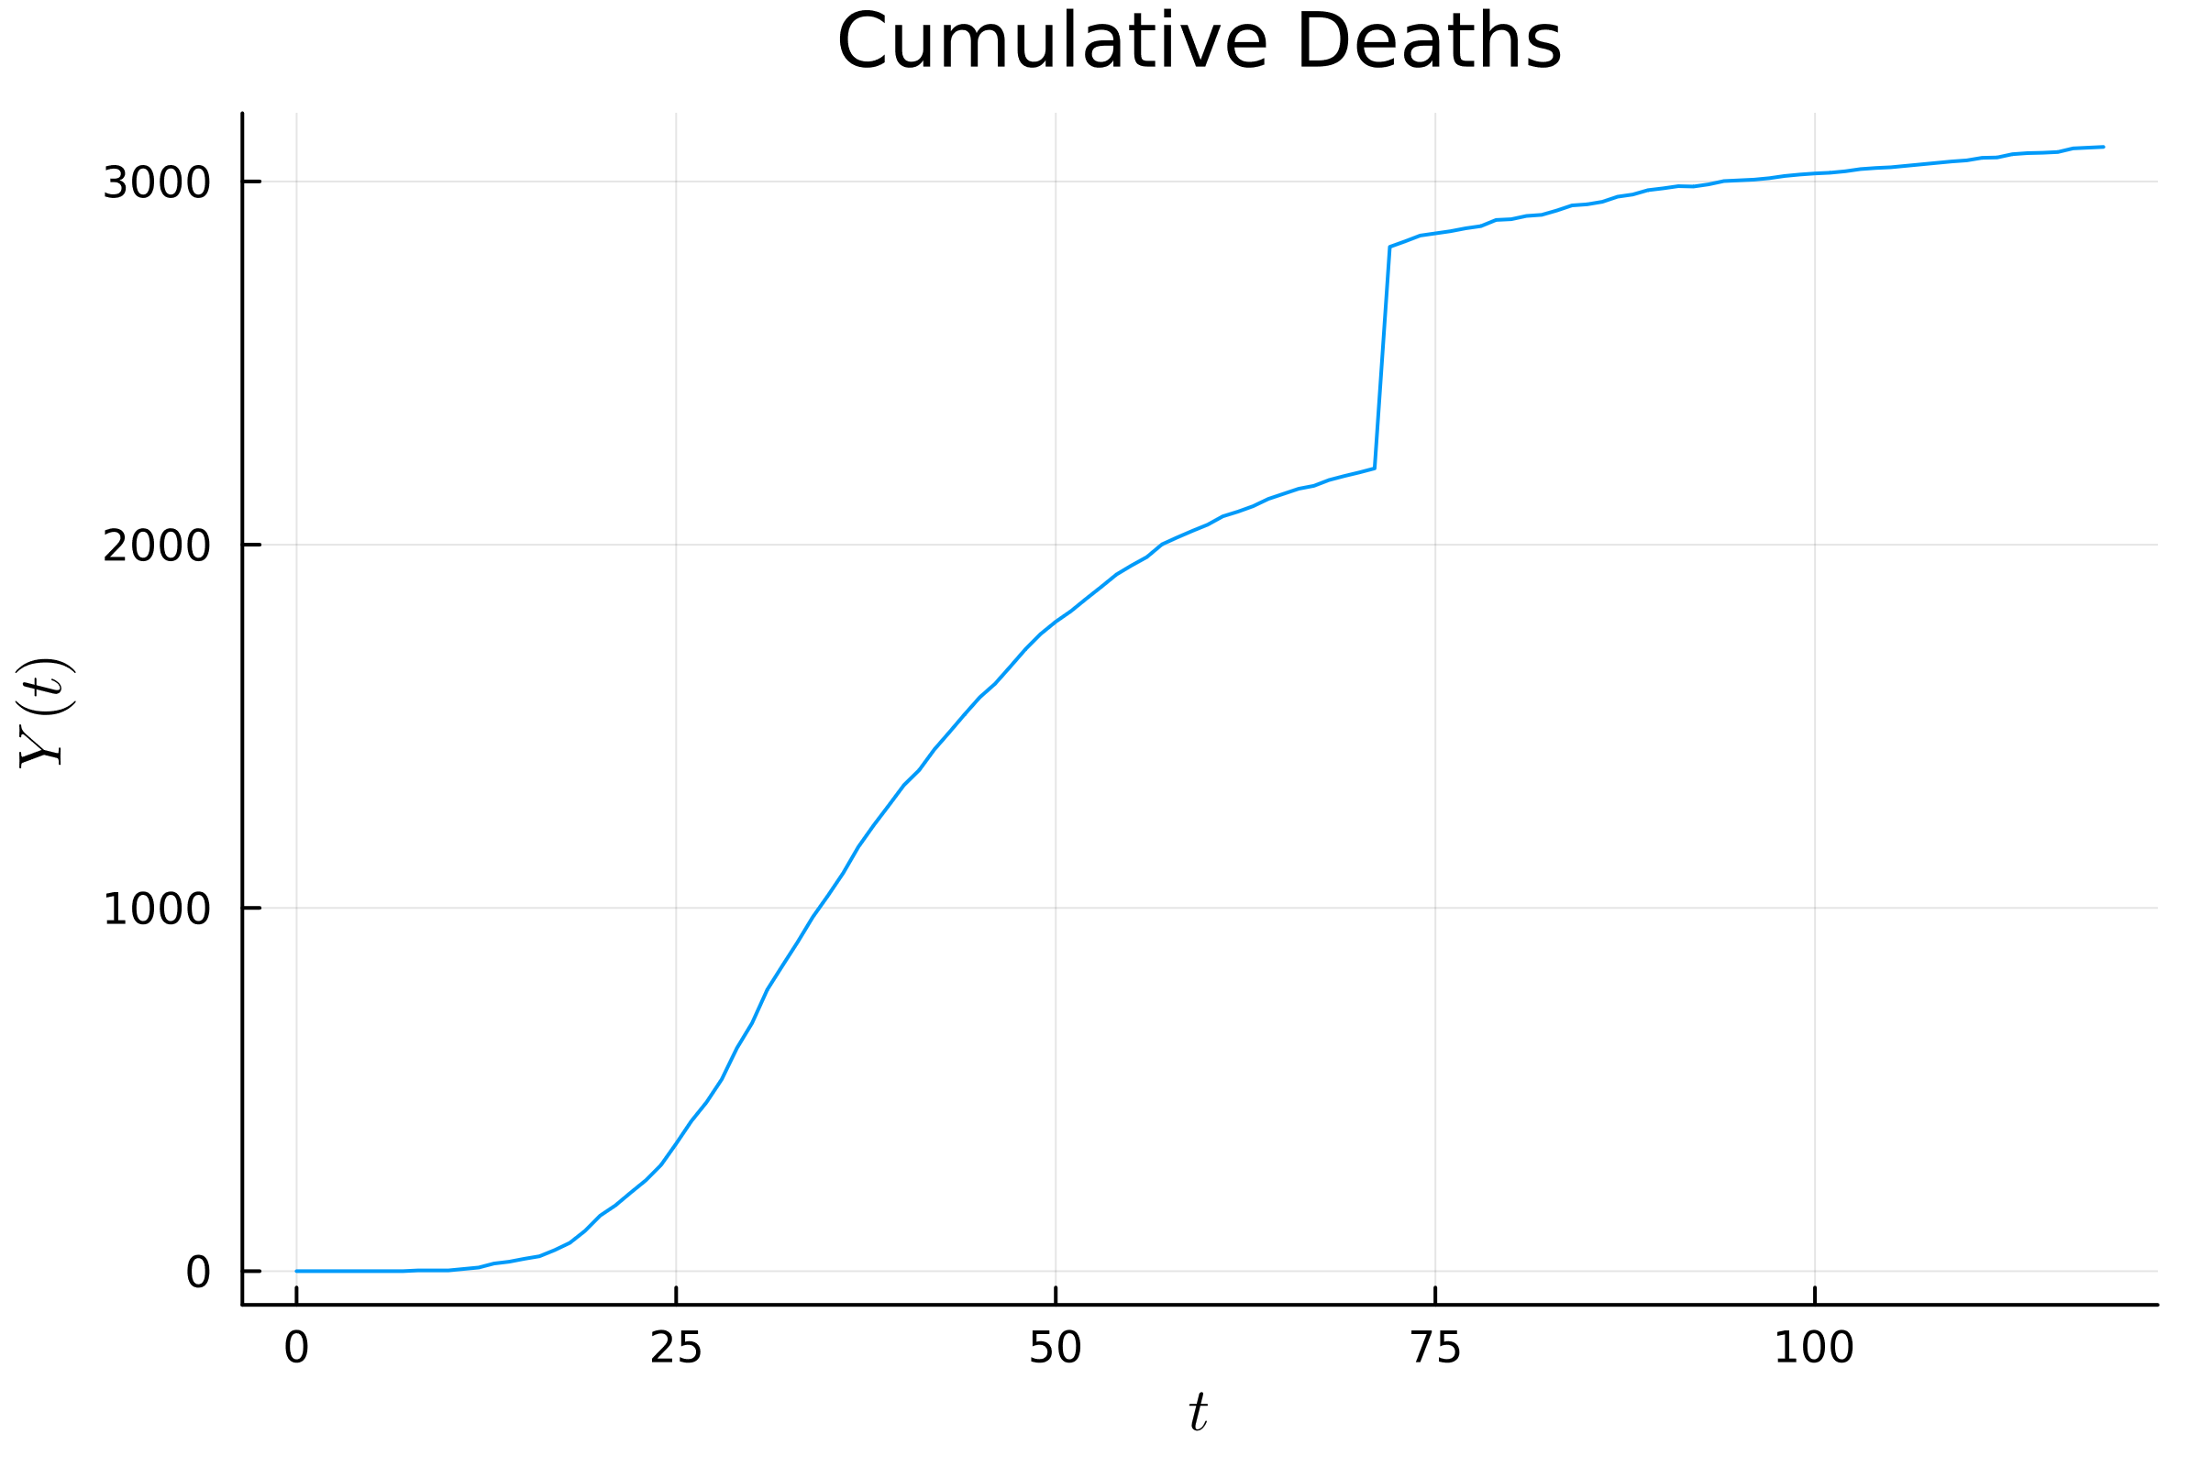
Large Jump in Death Data
Increase of 610 deaths between May 17, 2020 and May 18, 2020
Unlikely to be a normal increase unable to find exact reason for Manhattan
Similar jumps in data from other places have been caused by only reporting deaths with a positive PCR test as opposed to the cheaper and faster antigen test
One explanation is a change in which deaths are reported from not including deaths with a positive antigen test to including them

Slide 8
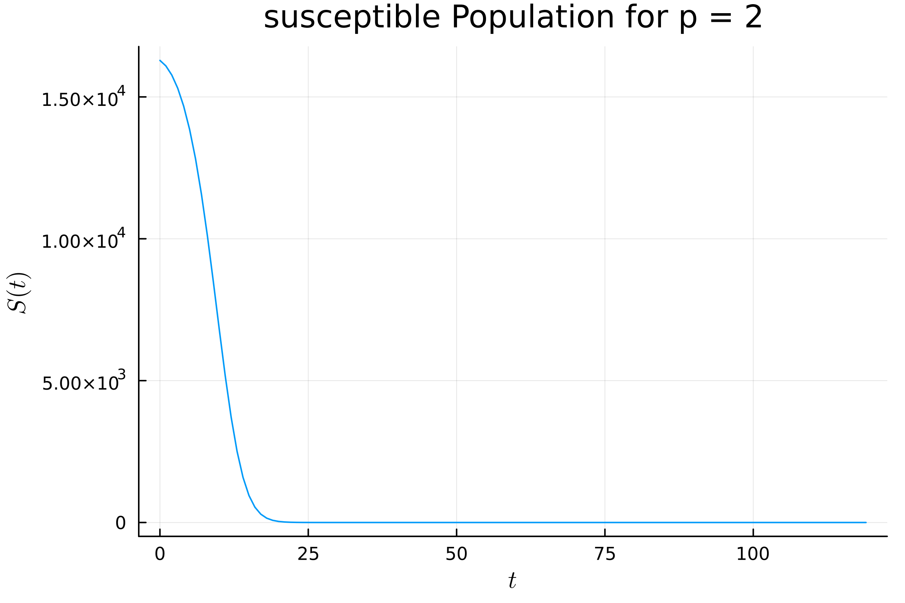
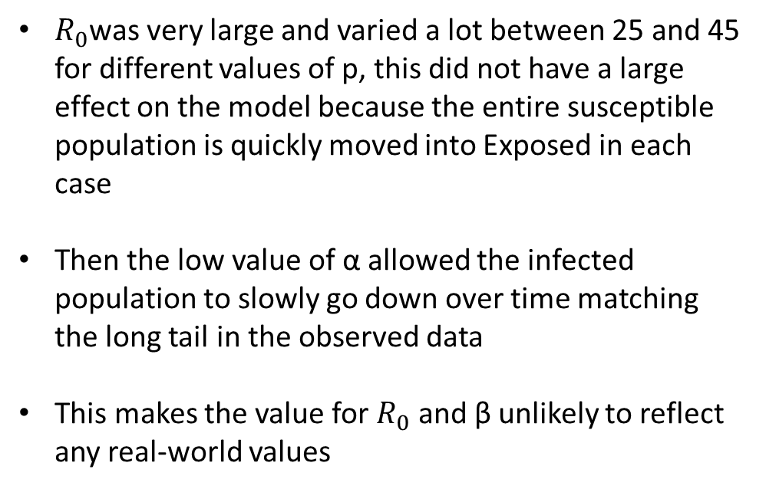
Accuracy of Parameters
$R_{0}$was very large and varied a lot between 25 and 45 for different values of p, this did not have a large effect on the model because the entire susceptible population is quickly moved into Exposed in each case
Then the low value of α allowed the infected population to slowly go down over time matching the long tail in the observed data
This makes the value for $R_{0}$ and β unlikely to reflect any real-world values

Slide 9
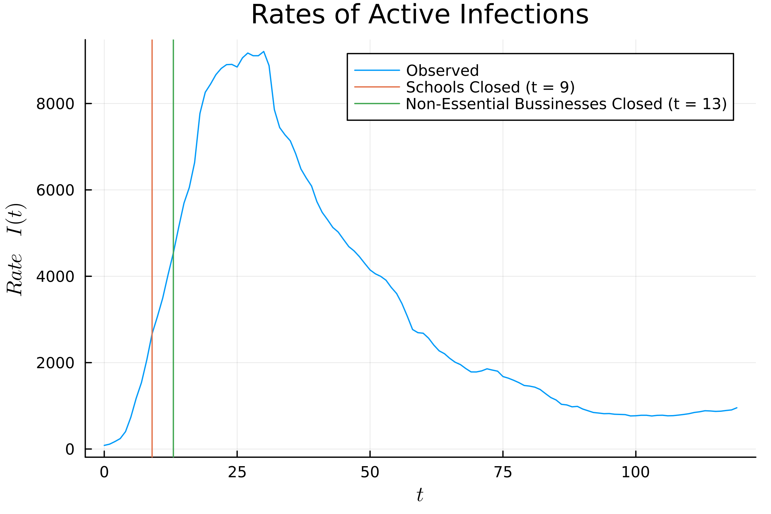
Reasons for Difficulty
The model only allows for a constant value of β
Changes in human behavior such as those due to a lockdown can cause a large change in β
This makes it difficult to fit the model to the observed data without it doing it in the weird way that we see

Slide 10
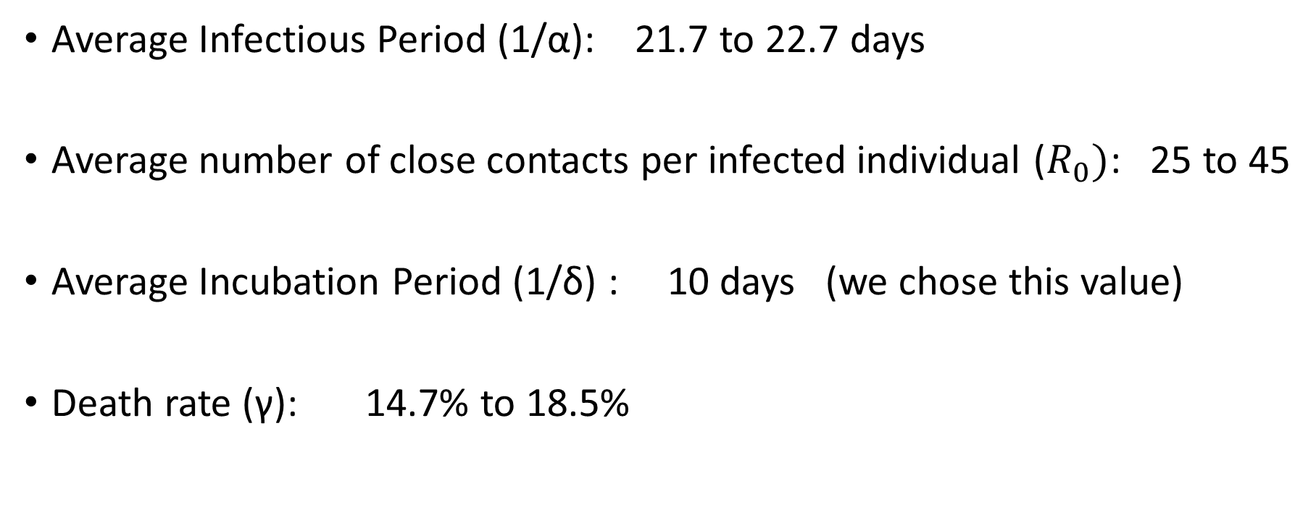
Interpretation of Parameters SEIR
Average Infectious Period (1/α): 21.7 to 22.7 days
Average number of close contacts per infected individual ($R_{0})$: 25 to 45
Average Incubation Period (1/δ) : 10 days (we chose this value)
Death rate (γ): 14.7% to 18.5%

Slide 11
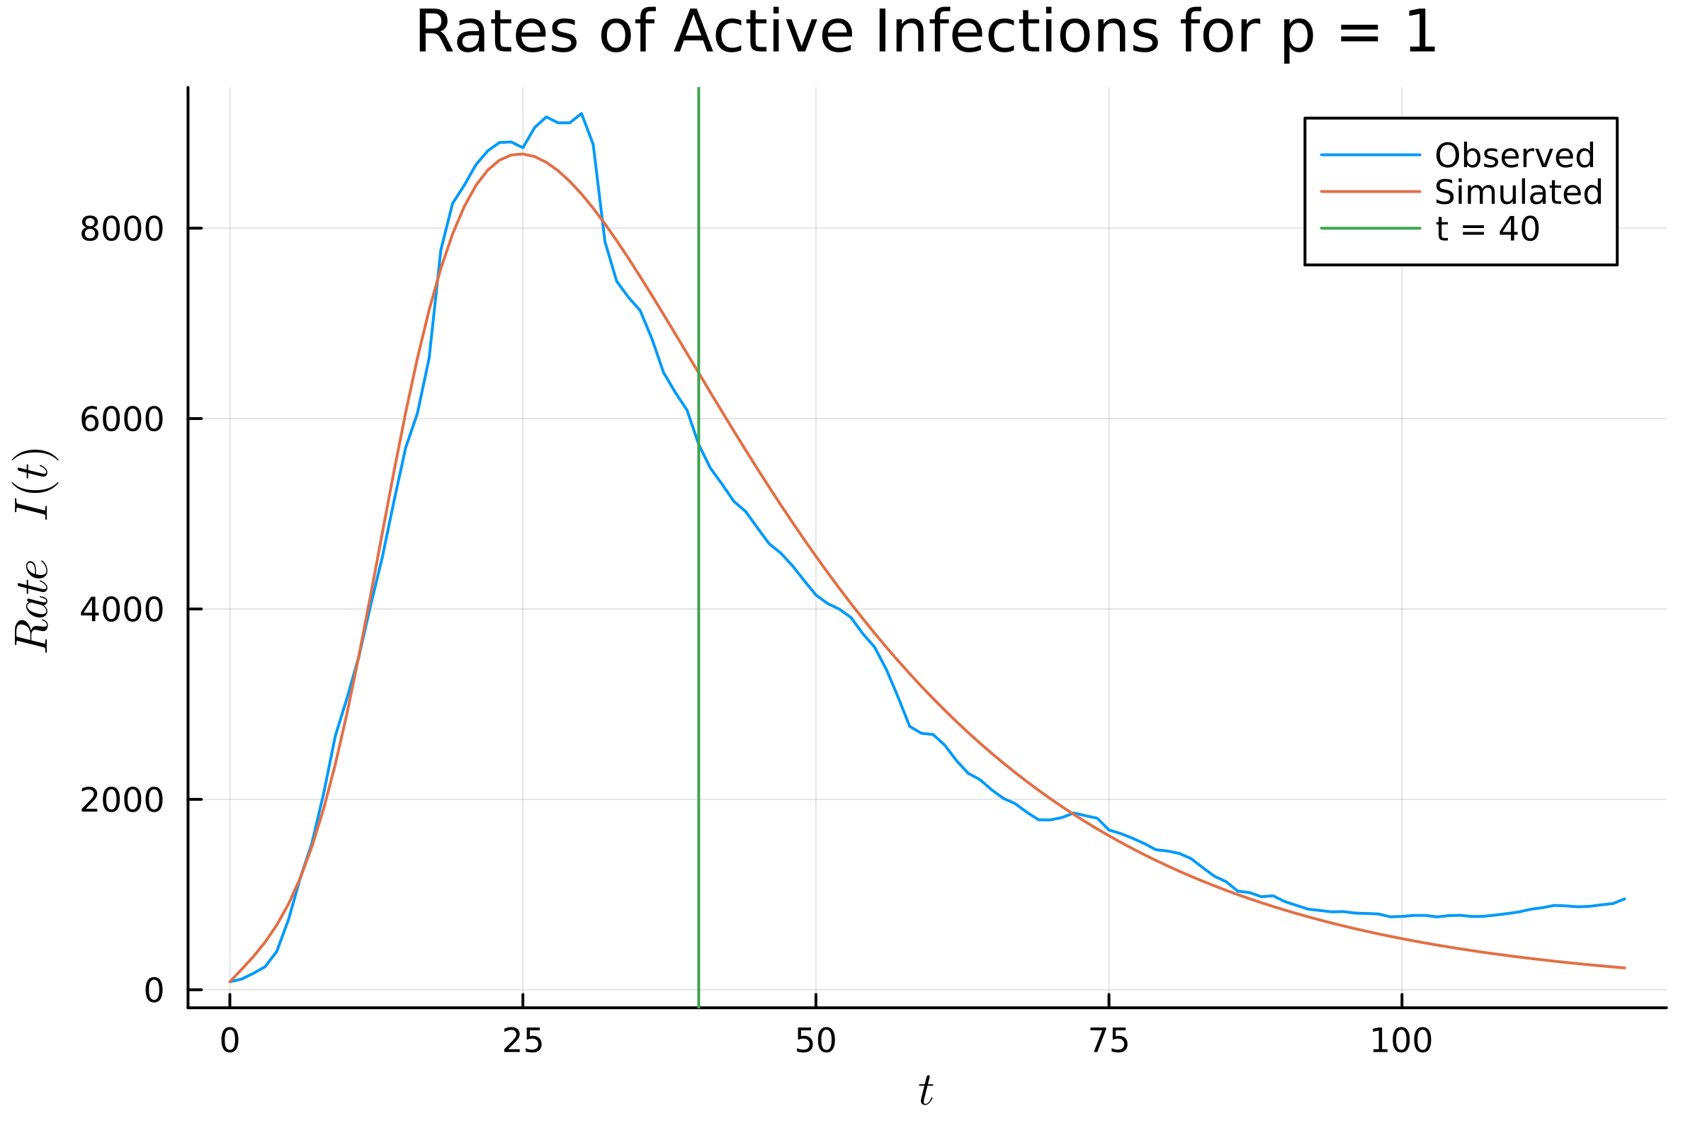

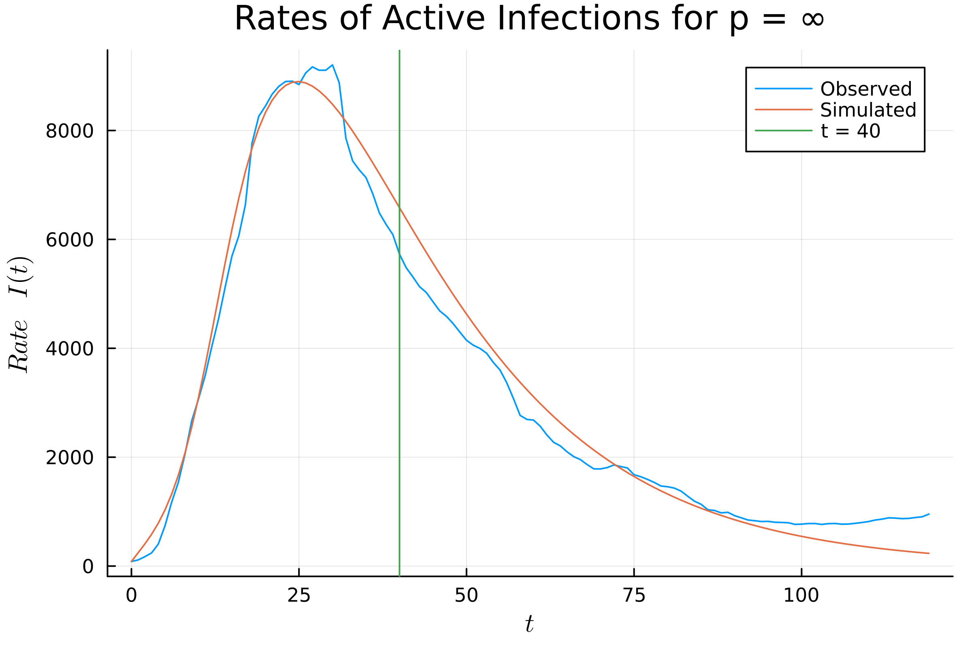
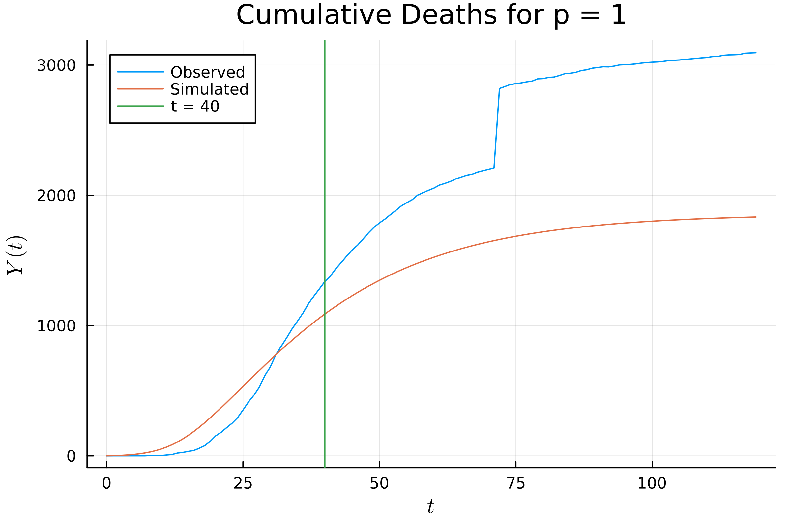
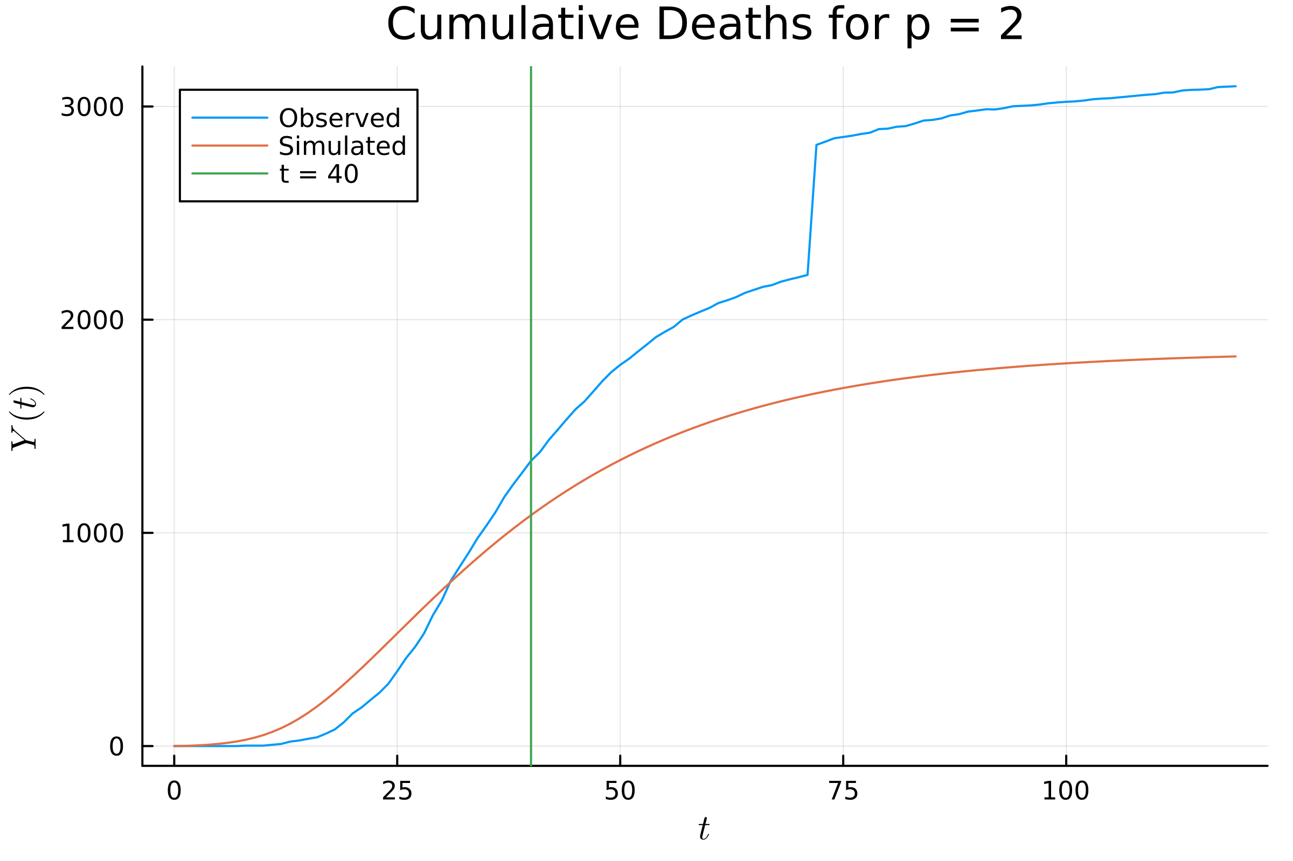

SEIR Model Prediction

Slide 12
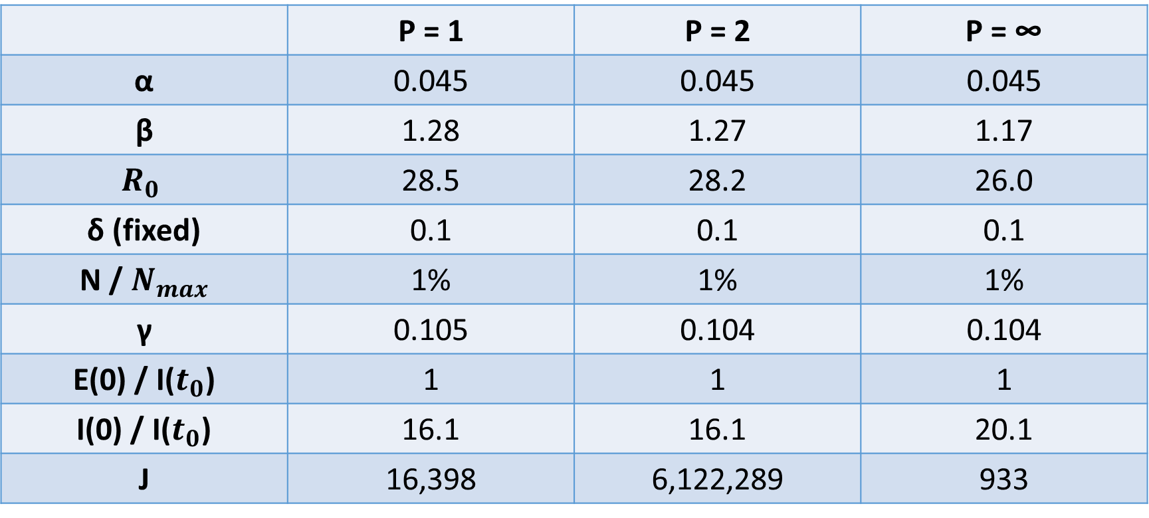
SEIR Model Parameters
 | P = 1 | P = 2 | P = ∞
α | 0.045 | 0.045 | 0.045
β | 1.28 | 1.27 | 1.17
$$R_{0}$$ | 28.5 | 28.2 | 26.0
δ (fixed) | 0.1 | 0.1 | 0.1
N / $N_{max}$ | 1% | 1% | 1%
γ | 0.105 | 0.104 | 0.104
E(0) / I($t_{0}$) | 1 | 1 | 1
I(0) / I($t_{0}$) | 16.1 | 16.1 | 20.1
J | 16,398 | 6,122,289 | 933

Slide 13
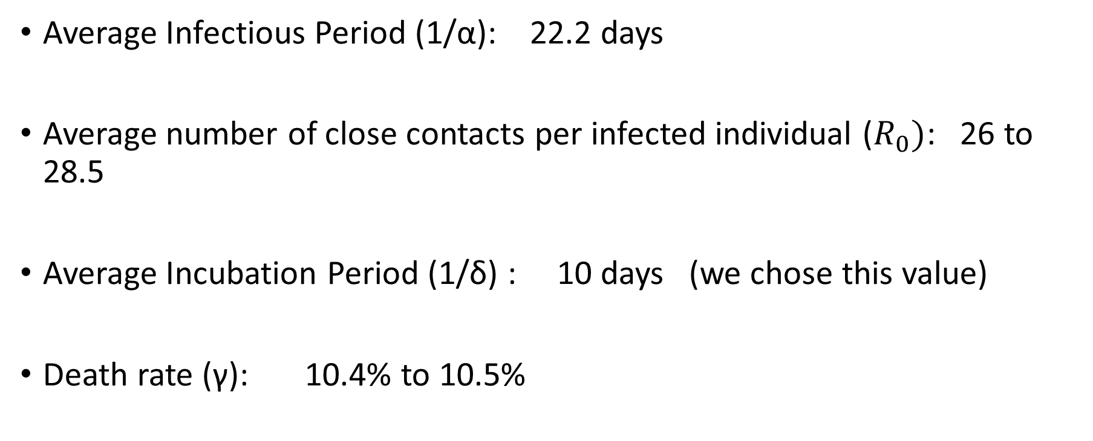
Interpretation of Parameters SEIR Predictions
Average Infectious Period (1/α): 22.2 days
Average number of close contacts per infected individual ($R_{0})$: 26 to 28.5
Average Incubation Period (1/δ) : 10 days (we chose this value)
Death rate (γ): 10.4% to 10.5%

Slide 14
Challenges With Implementation
Initially were not dividing by the total population when computing the Euler method solution to the differential equation
Code was running slow for the p=1 case

